Slide 1
Piano Room Device
Louis Hu, Drew Council, Haseeb Chaudhry, Ricky Weerts

Slide 2
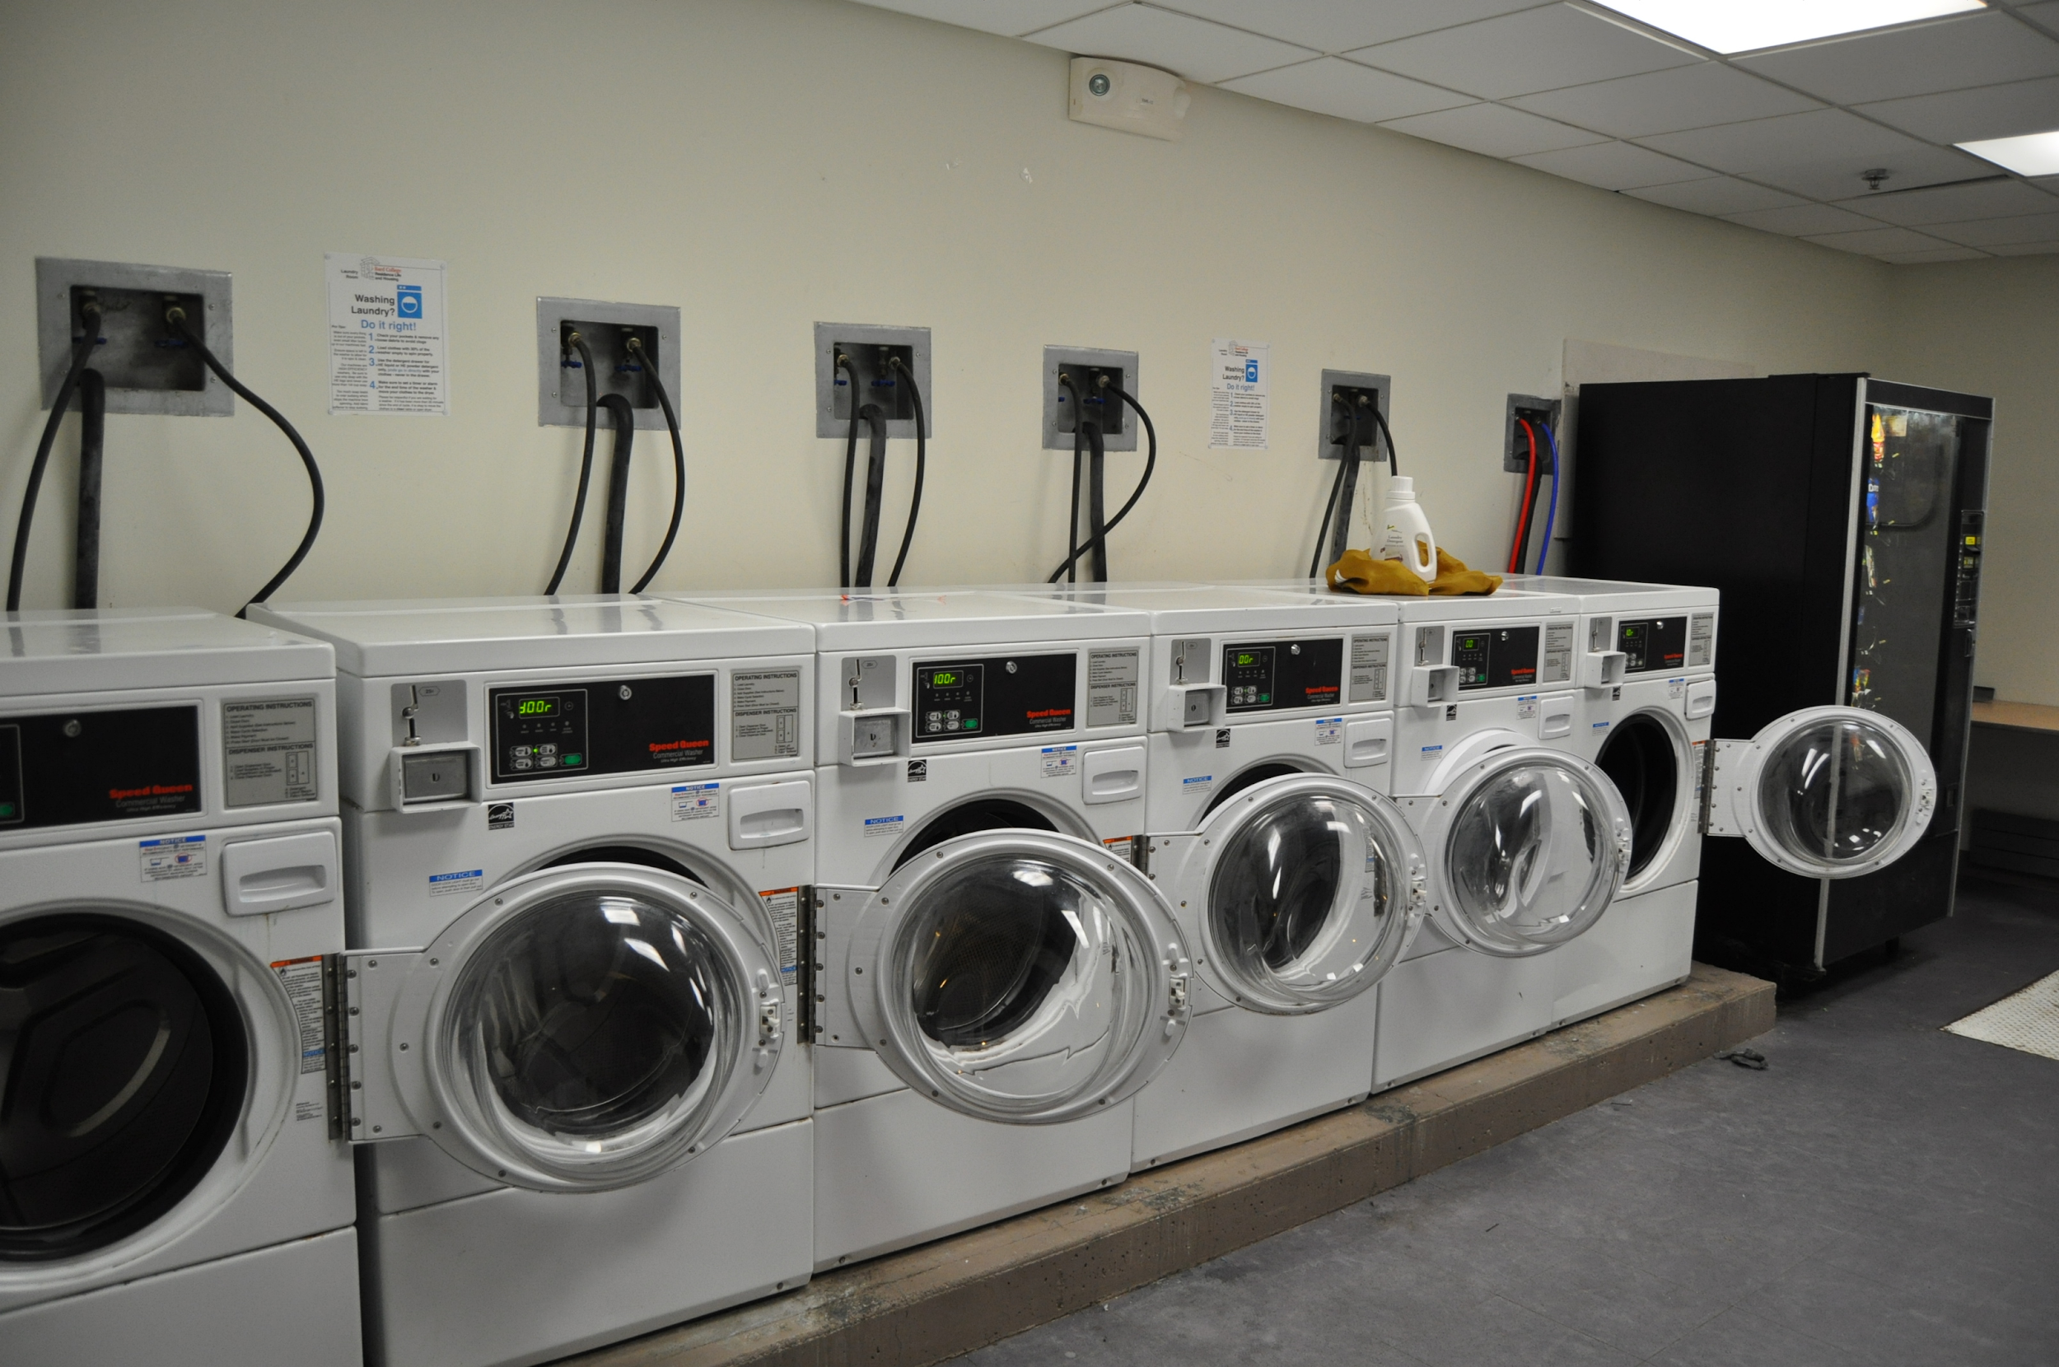
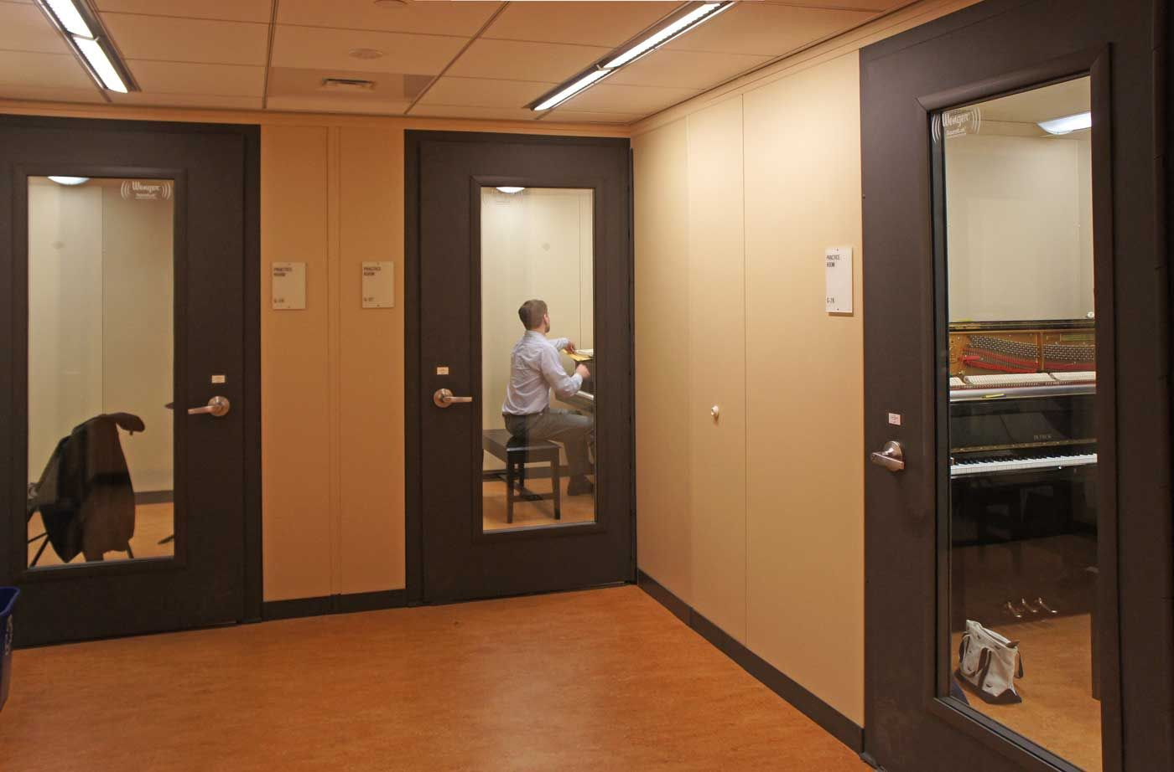
Motivation

Slide 3
Problem Statement
No way to find out if piano room is open remotely
Needs a system to allow users to check whether any rooms are available

Slide 4
Key Results
Physical Circuitry
Software
Sensor
Microcontroller
Casing
Back-end
Front-end

Slide 5
Design Objectives and Constraints
Objectives, Constraints | Target Value
Durability (objective) | >= 2-3 years, maintenance < every 6 months
Accessibility (objective) | Easier to use than physically going there, survey score > 8/10
Compatibility (constraint) | Works with IOS, Android, and Computers
Aesthetics (objective) | Approval rating > 80%. Hidden Wiring
Precision (objective) | Detection time < 2-3 minutes
Privacy (constraint) | Privacy rating > 95%. No Privacy Laws violated
Accuracy (objective) | False alarms < Failures to detect

Slide 6
Person is in the Room
Accuracy
YES
NO
Correct | Type 1 Error False Alarms
Type 2 Error Failure to Detect | Correct
YES
Detected
NO

Slide 7
Design Solution Ideas
PIR - Detects change in infrared radiation coming from objects in view
Ultrasonic - Uses sound waves to detect the distance from objects in a room
Temporal camera - Takes pictures of the room and compares pictures for differences over time
Body/face detection - Uses facial recognition technology to identify when a face or body is in the room

Slide 8
Pugh Scoring for Detection
 | Weight | PIR | Light Detection | Body/face detection | Temporal Camera | Background Compare | Ultrasonic | IR Camera
Accessibility | 0.0 | 3 | 3 | 3 | 3 | 3 | 3 | 3
Accuracy | 0.4 | 5 | 5 | 4 | 3 | 4 | 4 | 4
Compatibility | 0.0 | 3 | 3 | 3 | 3 | 3 | 3 | 3
Durability | 0.3 | 5 | 5 | 1 | 4 | 2 | 5 | 3
Precision | 0.25 | 3 | 1 | 5 | 4 | 5 | 3 | 4
Aesthetics | 0.05 | 4 | 5 | 1 | 3 | 3 | 4 | 3
Total | 1 | 4.45 | 4 | 3.2 | 3.55 | 3.6 | 4.05 | 3.65
RANK |  | 1 | 3 | 7 | 6 | 5 | 2 | 4

Slide 9
Pugh Scoring for Detection
 | Weight | PIR | Light Detection | Body/face detection | Temporal Camera | Background Compare | Ultrasonic | IR Camera
Accessibility | 0.0 | 3 | 3 | 3 | 3 | 3 | 3 | 3
Accuracy | 0.4 | 5 | 5 | 4 | 3 | 4 | 4 | 4
Compatibility | 0.0 | 3 | 3 | 3 | 3 | 3 | 3 | 3
Durability | 0.3 | 5 | 5 | 1 | 4 | 2 | 5 | 3
Precision | 0.25 | 3 | 1 | 5 | 4 | 5 | 3 | 4
Aesthetics | 0.05 | 4 | 5 | 1 | 3 | 3 | 4 | 3
Total | 1 | 4.45 | 4 | 3.2 | 3.55 | 3.6 | 4.05 | 3.65
RANK |  | 1 | 3 | 7 | 6 | 5 | 2 | 4

Slide 10
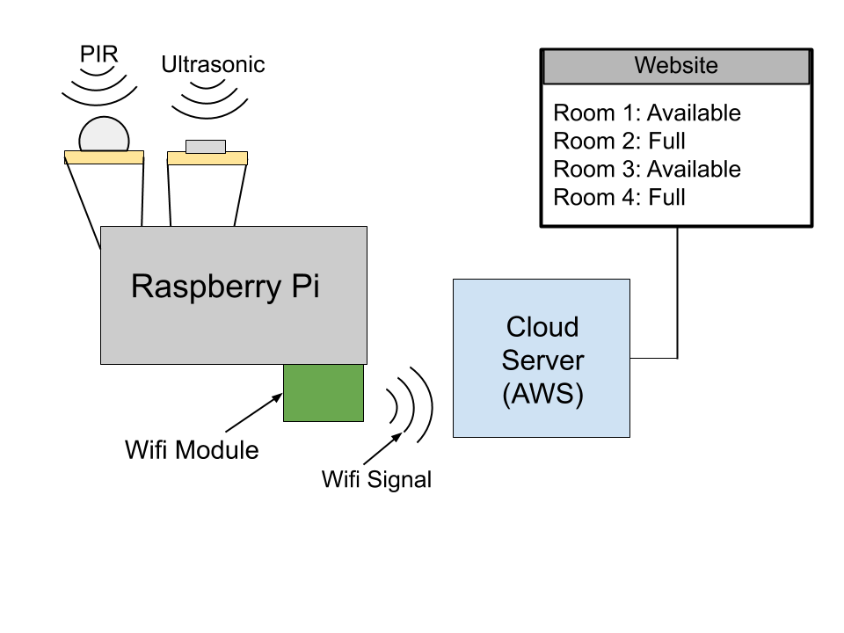
Design Sketch

Slide 11
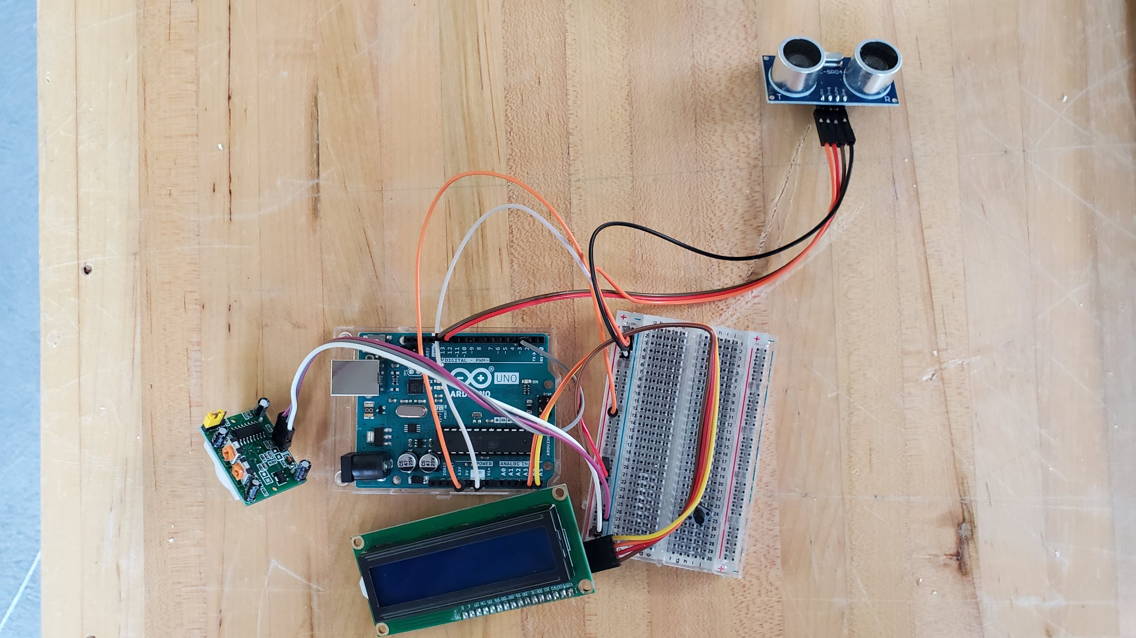
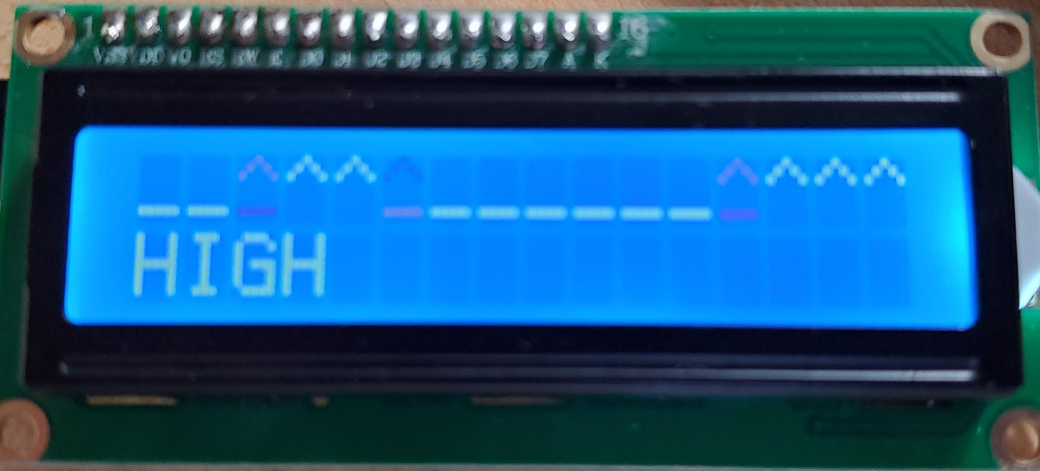
Sensor Prototype
Example Output
PIR Sensor
LCD Display

Slide 12
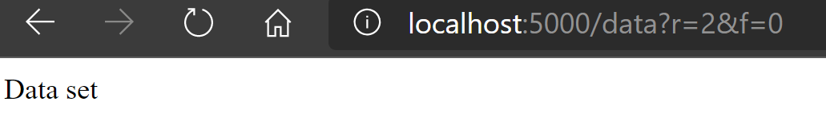
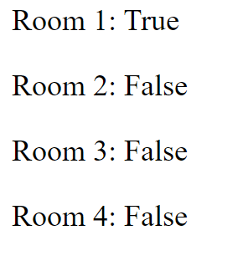
Website Prototype
Visiting a link (below), updates data on the site to show the occupancy of the rooms (right)
Update Data Page
View Data Page

Slide 13
Key Results
Physical Circuitry
Software
PIR & Ultrasonic Sensor
(Sensors)
Raspberry Pi
(Micro-
controller)
Acrylic/3D Print
(Casing)
Python
(Back-end)
Website
(Front-end)

Slide 14
Future Plans
Continue testing sensors and identify a configuration that works well for the room
Jam Session button
Improve website aesthetics
Get sensor circuit to connect to website
Perform testing to check the efficacy of our design

Slide 15
Conclusion
A system using PIR and Ultrasonic sensors to detect the presence of people and update a website accordingly
Will save piano users valuable time in checking the occupancy of piano rooms and increase efficiency of piano room usage

Slide 16
Acknowledgements
Dr. Rizk, Dr. West
Writing Consultant: Annie
Technical Mentor: Dr. Teng Su
TA: Will Inigo
Client: Catherine McMillan

